Slide 1
Capstone Data Project
Investigating which boroughs of London would match the quality of life desired by a group of professionals

Slide 2
The Problem
Client
The Big Company
Brief
The objective given:
Find five boroughs in London with:
Acceptable crime rate
High number of independent schools
Active night and out-and-about life
Motivation
Degrading economic and social conditions in home country
Large portion of business already conducted virtually in London
Full emigration of major stakeholders and head office to London

Slide 3



Services

Slide 4
The Progess
Data Requirements
Low crime
Many schools
Many activities
Methodology
JSON to get Borough Data
Map Boroughs
Cluster Boroughs based on Foursquare API
Select 5 Boroughs

Slide 5
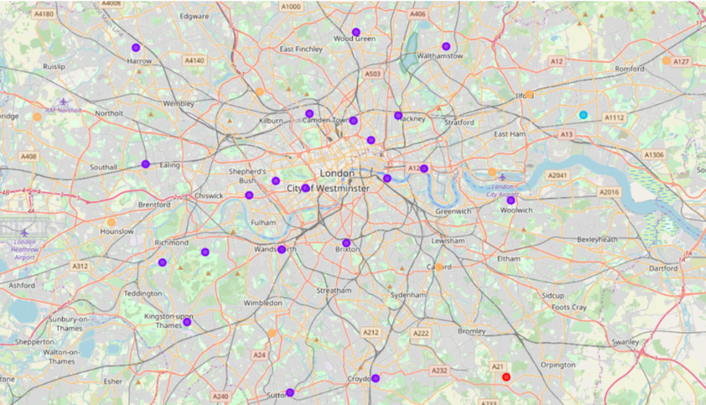
Clusters on Map
The largest cluster group (blue) contained the boroughs most ideal for The company

Slide 6
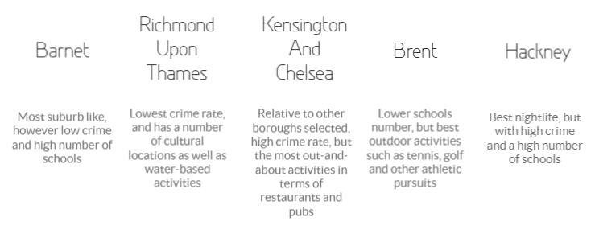
Selected Boroughs

Slide 7
Thank you!

